Slide 1

UFC Predictor
A quest to predict the unknown

Slide 2
Quest for W’s
The What, When & Where of Winning
Just like fighters strive for winning we strive to harness the power of data science to help us win by answering complex questions.
Our quest is to explore if there is a way to wrangle and distill data such that you’re able to determine future outcome of fighters based on previously fought bout data metrics.

Slide 3
What?
Why?
Where?
01
02
03
Topic:
Source:
Our Process:
Use data and fighter statistics to create an educated prediction on who will win the fight.
We acquired a dataset from UFC saved in Kaggle.com
As fans it would be interesting to best predict who will win a fight.

Slide 4
What do we plan on answering:
1. Top 1-5 metrics that contribute to winning
2. Which of the 5 metrics carry more weight than the other
3. Do these metrics differ according to weight class?
4. Do win streaks predict necessarily a higher chance of winning?
5. What is the optimal win streak that best predicts a win?

Slide 5
Data Exploration phase
Blue
Red
Differences in the average accuracy of takedowns taking place between fighters where calculated by using the following function, “Blue corner score - Red corner score” where a negative score actually favors the Red corner fighter.
Exploring historical data of past matchups in the UFC for past multiple years, it was found that the great majority of the time, the fighter in the red corner usually comes out as the victor in a match-up

Slide 6



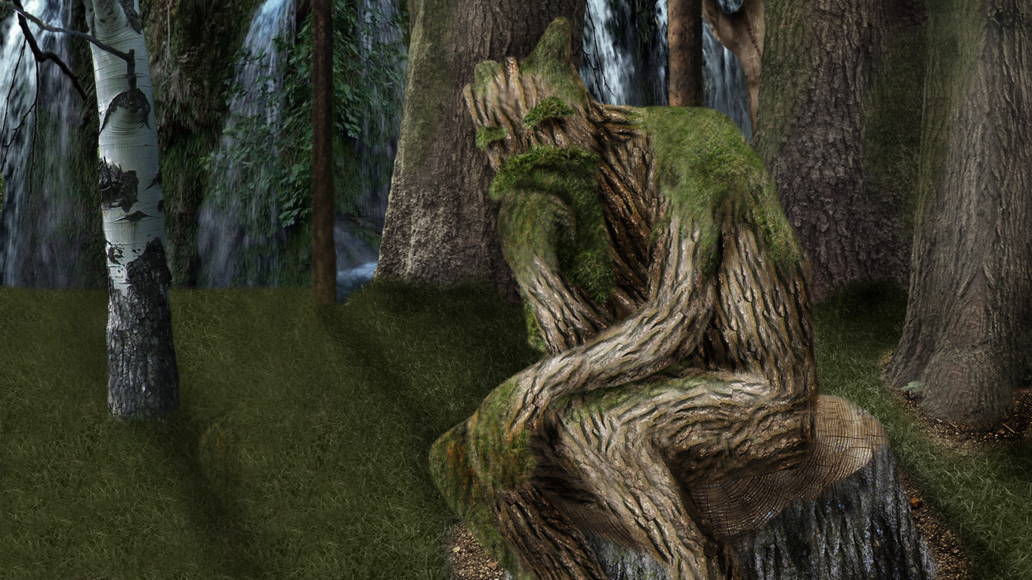
Analysis Phase
-We will compare the following 4 models to see which model best fit our data, research requirements and structure.
K-Nearest Neighbors
Random Forest Model
Decision Trees
Logistic Regression Models
Random forest is a supervised learning algorithm
Algorithm is a simple, supervised machine learning algorithm
Builds regression or classification models in the form of a tree structure
Basic statistical model that uses a logistic function to model a binary dependent variable

